Slide 1
Progress Report
Progress Report
Team 1 – Remote Biomedical Monitoring
Group G12
21/10/2026 · Week 5
1
Notes:
1

Slide 2
Project Overview
 | W4 | W5 | W6 | W7 | W8 | W9 | W10 | W11 | W12 | W13 | W14
WP0 Mgmt
WP1 LoRaWAN |  |  |  | B1
WP2 BITalino
WP3 ECG proc. |  |  |  |  |  |  |  | B2
WP4 Platform |  |  |  |  |  |  |  |  | B3
WP5 Integration |  |  |  |  |  |  |  |  |  |  | D1/D2
Done
Planned
B1/B2/B3 = block deliverables, D1/D2 = final
Issues:
WP1: On schedule. Network set-up in TTS completed (gateway + end device registered). Uplink/downlink tests start in W6 as planned.
Watch point – B1 (03/11): 8 of 10 tasks are concentrated in W6 and depend on the first uplink. Task 1 done; Task 4 advanced this week. No WP extension expected
2
Notes:
2

Slide 3
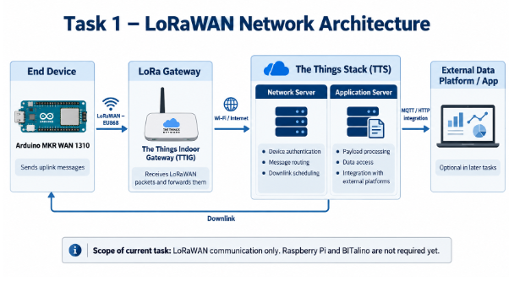
Achievements
✔ Project plan & system design delivered (W4)
6 work packages, Gantt W4–W14, responsibles assigned
✔ LoRaWAN network set up in TTS (Task 2)
The Things Stack Cloud, cluster eu1 (eu1.cloud.thethings.network)
Application created: pbe-team1-2026
End device registered: pbe-team1-arduino (Arduino MKR WAN 1310)
TTIG gateway registered and connected to TTS
✔ LoRaWAN architecture diagram (Task 1)
End device, gateway, network and application server identified
Task 1 – Deployed LoRaWAN network architecture
3
Notes:
3

Slide 4
Blocked actions
No blocked actions this week
Gateway and end device are registered and connected in TTS; the network is ready for the first uplink
Critical path: first uplink (Task 3)
Tasks 3–10 of B1 (uplink, ACKs, performance tests, downlink) depend on it
Task 1 (architecture diagram) done; Task 4 (payload formatter, testable with emulated bytes in TTS) advanced in parallel
Risk: range and SF tests (Tasks 6–7) may need extra sessions outside lab hours in W6.
4
Notes:
4

Slide 5
Planned Action Points
AP# | Status | WP | Resp. | Description | End | Depends on
AP1 | Done | WP1 | Pol | Register TTIG gateway and MKR WAN 1310 in TTS (Task 2 screenshots) | W5 | -
AP2 | Done | WP1 | Bruno | Diagram of the deployed LoRaWAN system (Task 1) | W5 | -
AP3 | Starting | WP1 | Ares | First uplink from MKR WAN 1310, ACKs, export JSON logs (Task 3) | W6 | AP1
AP4 | Planned | WP1 | Joan | Custom payload formatter decodeUplink (Task 4) | W6 | -
AP5 | Planned | WP1 | Raúl | Performance analysis: redundancy, range, SF, conclusions (Tasks 5–8) | W6 | AP3
AP6 | Planned | WP1 | Pol, Bruno | Sensor-block emulation and downlink tests (Tasks 9–10) | W6 | AP3
AP7 | Planned | WP1 | All | Assemble B1 deliverable: PPT, JSON logs, LogsOutline.txt, GitHub | W7 (03/11) | AP1–AP6
AP8 | Planned | WP2 | All | Prepare Raspberry Pi 4 and BITalino Bluetooth link | W7 | -
AP9 | Running | WP0 | All | Weekly progress reports | W14 | -
5
Notes:
5

Slide 6
Other issues
Logging of B1 evidence
TTS keeps ‘Live Data’ only for a limited time → JSON logs (gateway + application) exported right after every test
A LogsOutline.txt with start/end time per task will be kept from Task 3 onwards
Range test logistics (Task 6)
Needs time and approximate location of every packet sent → outdoor session with the MKR on battery and a laptop
To be scheduled in W6
Team workload
Only 2 members assigned to WP1 → rest of the team supports the performance tests (Tasks 5–7) to secure 03/11
6
Notes:
6

